Slide 1
Demand Transference
27-07-2020

Slide 2
Analytical Approach
Data Preprocessing
Bitesize & Share packs
Gums Mints & Sugar
Self Consumption
Similarity Score
Brand
Product
Flavor
Packsize
Nut Type
Milk/Dark Chocolate
Low Data: Total Observation <= Total unique weeks in data*90%
Low Revenue: sum(Weekly $ sold by PPG )/Total Number of quarters < = 0
Low Variance: Standard Deviation in Sales unit < = 1% & Standard Deviation in Weekly Sold Average Price <= 1%
SKU’s with Positive Correlation between Price & Sales Units > 0.2
Segmentation
Similarity Index
MODEL
Loss – SKU Dropped
Drop One SKU at a time in the assortment and recalculate the similarity index and based on the Transition flag change – Compute the Loss of Sales drop in Jan 2020
Retention- SKU Dropped
Identify the SKU similar to the SKU dropped using the similarity index and calculate the incremental sales in Jan 2020
Retention =(Incremental Sales from Similar SKU/Loss of Sales by SKU dropped)
Variables : Brand Sales, Category Sales, Similarity Index, SKU attributes, Flags to indicate any discontinued time period transition time (3 months)
Model Development Time Period 2 years (Jan 2018- Dec 2019)
Scoring & Test Time Period: Jan 2020
Lasso Model: Establishes linear relationship between Monthly sales of the SKU’s in the segment with the features
Demand Transference

Slide 3
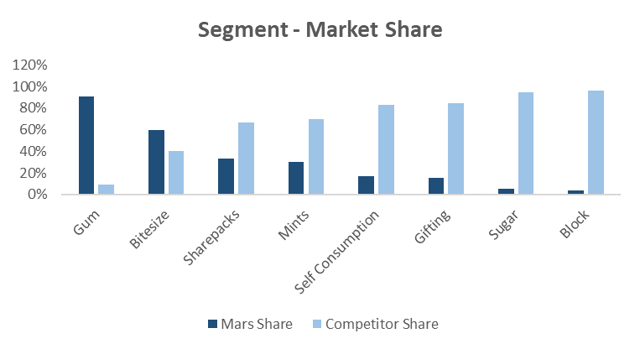
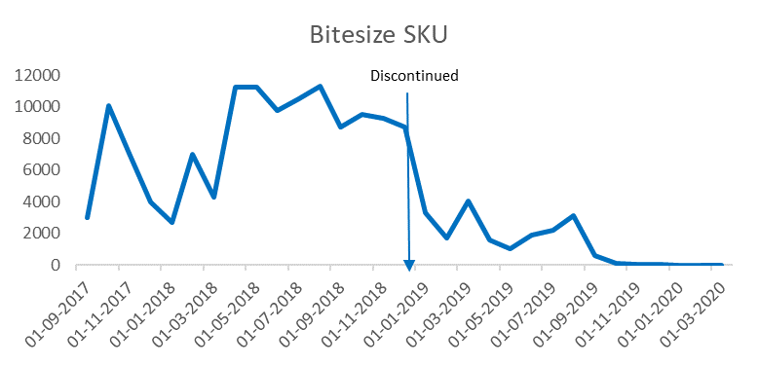
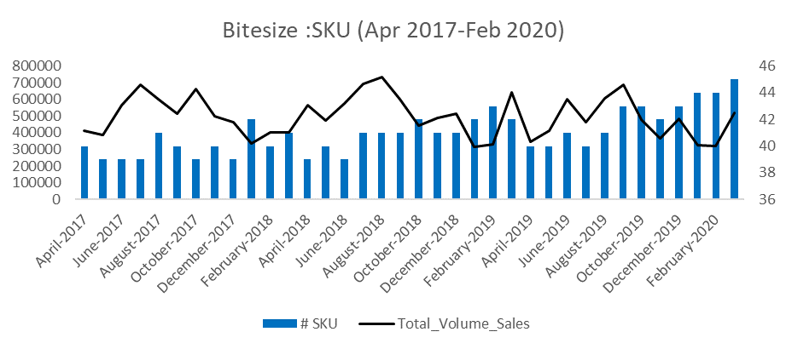
SKU Overview
Time Period: June 2017 – Dec 2019
Combined Model

Slide 4
Bitesize
Actual Sales Lost Jan 2020 Maltesers 140 g= 16,128
Incremental Sales from Similar SKUs= 3046
Retention = 18%

Slide 5
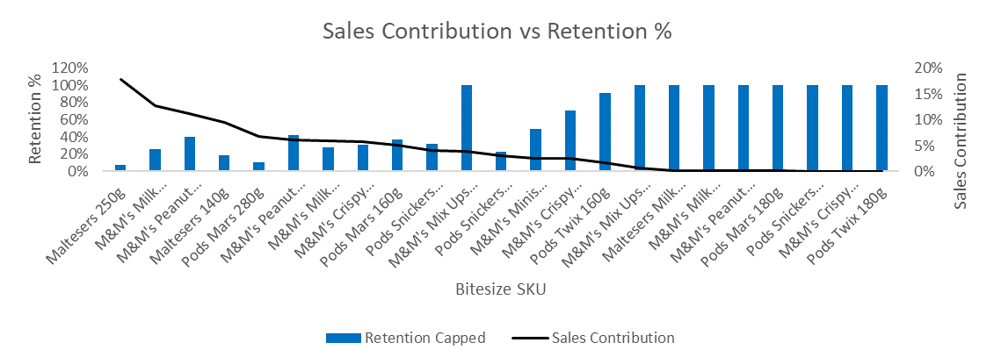
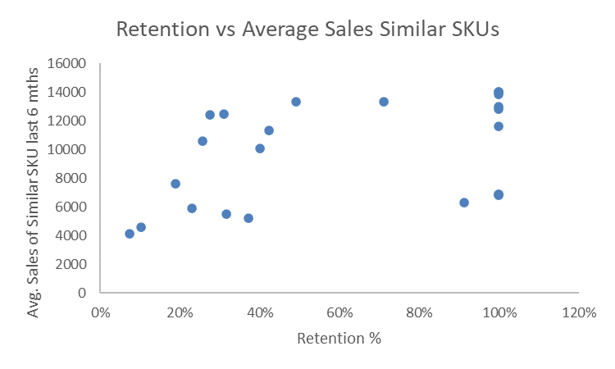
Bitesize
Overall Retention % across all SKUs as of Jan 2020 simulated by dropping 1 SKU at a time in the assortment.
Low Contributing SKU’s in the assortment have higher retention by the existing similar SKUs
SKUs with similar SKU with high Sales Contribution have higher retention %

Slide 6
Summary & Limitations
Gums the retention rates are higher compared to other segments as Mars has higher market share ~90%
On an average there is 12% - 22% retention across segments not considering the SKU’s with low contribution
Across all segments SKU’s with higher sales contribution have lesser retention percentage
Currently in the similarity index calculation Packsize and Price are not considered
Any new addition of SKU at the time of Scoring is not taken into account while calculating the % Retention
Discontinued SKU date to create Transition flag is currently based on current month sales 70% less than last 4 months average
Multiple skus dropped at the same time is not in the scope of this study.
This method was not tested on the Seasonal ppgs
In the current scope the validation done is a check for sku’s with higher retention if the similar sku’s are high contributing skus or the sku dropped is a low contributing sku which can be replaced easily, similarly if a sku has lower retention either it has high contribution and lower number of similar skus. (No metric as such)

Slide 7
APPENDIX

Slide 8
Bitesize

Slide 9
Similarity Index
Current Assortment – Similarity Index
New Assortment – Similarity Index
UPC | Brand | Product type | Brand Score | Product Score | Similarity Score
SKU1 | Brand 1 | p1 | 0.30 | 0.40 | 0.70
SKU2 | Brand 1 | p1 | 0.30 | 0.40 | 0.70
SKU3 | Brand 1 | p1 | 0.30 | 0.40 | 0.70
SKU4 | Brand 2 | p1 | 0.10 | 0.40 | 0.50
SKU5 | Brand 3 | p2 | 0.20 | 0.60 | 0.80
SKU6 | Brand 3 | p2 | 0.20 | 0.60 | 0.80
SKU7 | Brand 4 | p2 | 0.40 | 0.60 | 1.00
SKU8 | Brand 4 | p2 | 0.40 | 0.60 | 1.00
SKU9 | Brand 4 | p2 | 0.40 | 0.60 | 1.00
SKU10 | Brand 4 | p2 | 0.40 | 0.60 | 1.00
For eg. SKU1
Brand Score=3/10=0.3
Product Score=4/10=0.4
Similarity Score=0.3+0.4
=0.7
Dropping SKU1

Slide 10
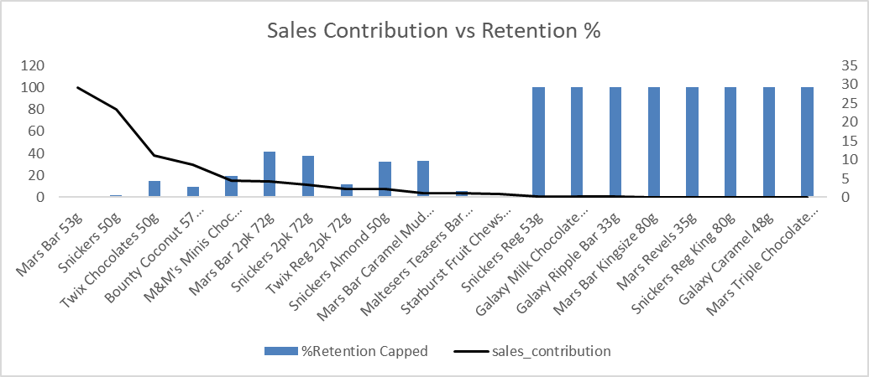
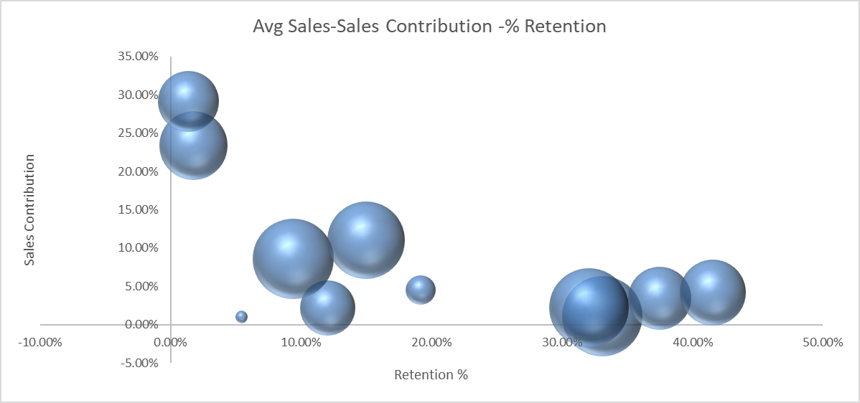
Self Consumption

Slide 11
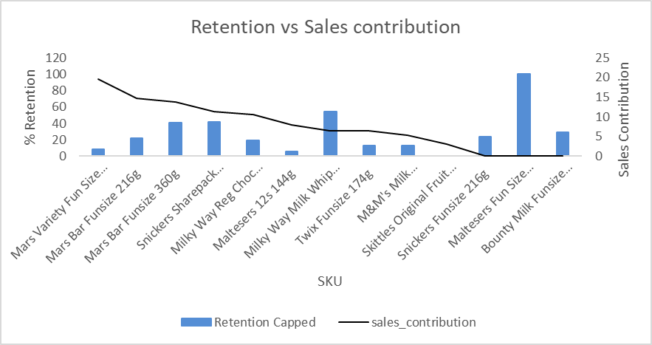
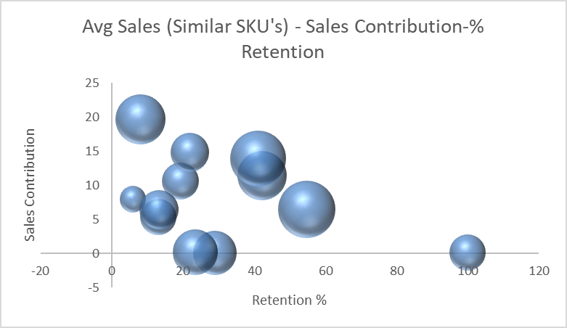
Sharepacks

Slide 12
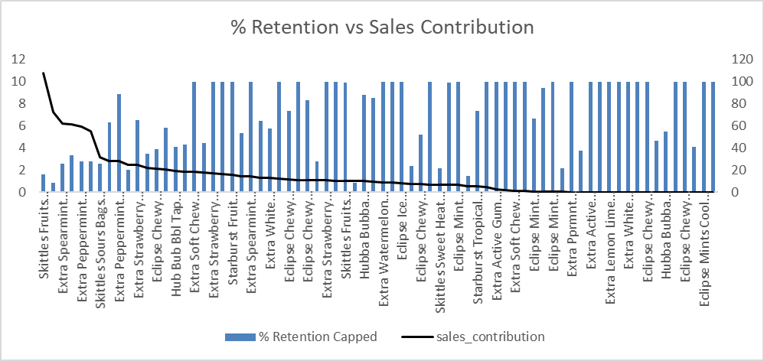
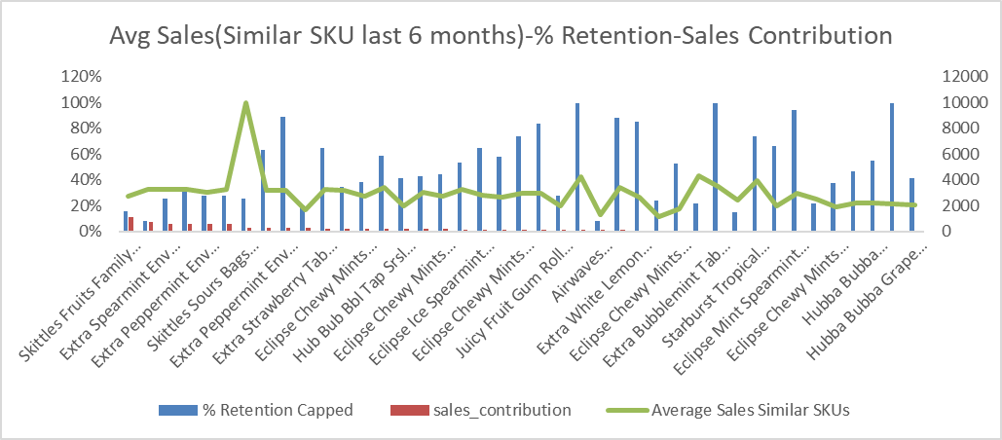
Mints , Gums & Sugar

